Slide 1
Final Project
Team 3
陳心怡、王啟龍、孫際恬
(依報告順序)

Slide 2
Image Classification on CINIC-10

Slide 3
What is CINIC-10
Motivation
CIFAR-10 is too small and too easy
ImageNet is too large and difficult
CIFAR-10 (60,000 images, 32x32 RGB) + ImageNet (210,000 selection images, 32x32 RGB)
https://datashare.is.ed.ac.uk/handle/10283/3192
4x CIFAR-10
3 sets: Train(90,000 images), Validation(90,000 images), Test(90,000 images)
10 classes: Airplane, Automobile, Bird, Cat, Deer, Dog, Frog, Horse, Ship, Truck
Available date: 2018/9/28
655.6 MB

Slide 4
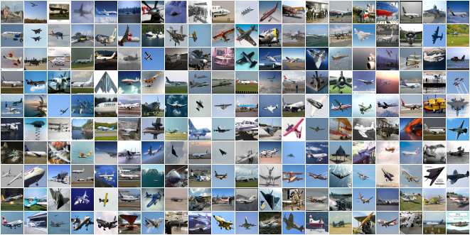
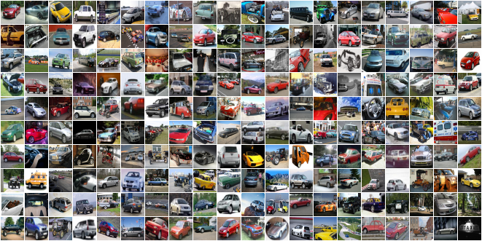
Examples
Airplane
Automobile

Slide 5
Benchmarks
Conditions:
Trained on the combined train and validation sets, and tested on the test set.
300 epochs training,
initial learning rate was 0.1 and cosine annealed to zero,
momentum 0.9
weight decay 0.0001
batch size 64
Model | No. Parameters | Validation Error
VGG-16 | 14.7M | 12.23 +/- 0.16
ResNet-18 | 11.2M | 9.73 +/- 0.05
ResNet-18 (preact) | 11.2M | 10.10 +/- 0.08
GoogLeNet | 6.2M | 8.83 +/- 0.12
ResNeXt29_2x64d | 9.2M | 8.55 +/- 0.15
Densenet-121 | 7.0M | 8.74 +/- 0.16
Mobilenet | 3.2M | 18.00 +/- 0.16

Slide 6
Dataloader (I)
Official
But…
import torchvision
import torchvision.transforms as transforms
cinic_directory = '/path/to/cinic/directory'
cinic_mean = [0.47889522, 0.47227842, 0.43047404]
cinic_std = [0.24205776, 0.23828046, 0.25874835]
cinic_train = torch.utils.data.DataLoader(
torchvision.datasets.ImageFolder(cinic_directory + '/train',
transform=transforms.Compose([transforms.ToTensor(),
transforms.Normalize(mean=cinic_mean,std=cinic_std)])),
batch_size=128, shuffle=True)

Slide 7
Dataloader (II) - Statistics Problem
After normalization by mean [0.47889522, 0.47227842, 0.43047404] and standard deviation [0.24205776, 0.23828046, 0.25874835], the data input would not be in [-1, +1]
Using mean [0.5, 0.5, 0.5] and standard deviation [0.5, 0.5, 0.5] would be better

Slide 8
Dataloader (III) - Consuming time problem in data loading
Reading 270,000 files each epoch would take too much time
Packing and saving them into two NPZ file, cinic10_train.npz & cinic10_test.npz
def save_npz(self):
data_path = self.root+'cinic10'
data_train, label_train = [], []
data_test, label_test = [], []
for s in self.sets:
for c in self.classes:
source_directory = '{}/{}/{}'.format(data_path, s, c)
filenames = glob.glob('{}/*.png'.format(source_directory))
i = 0
for fn in filenames:
img = Image.open(fn).convert('RGB')
img = np.array(img)
if s == 'train' or s == 'valid':
data_train.append(img)
label_train.append(self.classes.index(c))
elif s == 'test':
data_test.append(img)
label_test.append(self.classes.index(c))
np.savez(self.root+self.train_npz, data=data_train, label=label_train)
np.savez(self.root+self.test_npz, data=data_test, label=label_test)

Slide 9
Dataloader (IV) – class CINIC10_NPZ
class CINIC10_NPZ(data.Dataset):
def __init__(self, root='./data/', train=True,
transform=None, target_transform=None, autogen=True):
self.root = root
self.transform = transform
self.target_transform = target_transform
self.train = train # training set or test set
self.autogen = autogen
self.downloaded_list = self.train_npz if self.train else self.test_npz
self.data = []
self.targets = []
file_name = self.root+self.downloaded_list
entry = np.load(file_name)
self.data = entry['data']
def __getitem__(self, index):
img, target = self.data[index], self.targets[index]
img = Image.fromarray(img)
if self.transform is not None:
img = self.transform(img)
if self.target_transform is not None:
target = self.target_transform(target)
return img, target
def __len__(self):
return len(self.data)

Slide 10
Experiment flow
Network model
resnet20_cifar
Baseline model
Learning rate: Initial 0.3, CosineAnnealingLR, T_max 290, from 10 to 300 epoches
Pruning by resuming baseline model
L1RankedStructureParameterPruner: [0.6, ‘3D’], from 430 to 500 epoches
Learning rate: Initial 0.03, StepLR, step_size 45, from 45 to 500 epoches
Thining by resuming pruned model
Fail due to pytorch version 0.4.1 in NCHC server !!
Invoked with: OperatorExportTypes.RAW, False

Slide 11
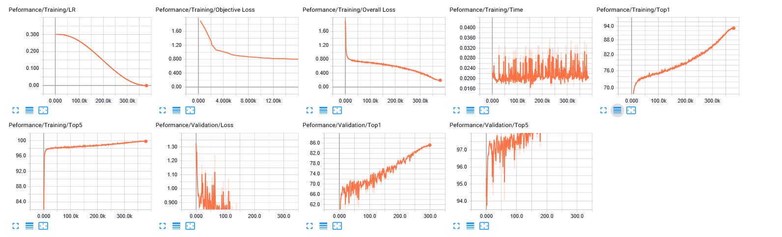
Baseline model
Best Top1: 85.367 On Epoch: 299
Total MACs : 40,813,184
Total Weights: 270,896
USE GPU
CPU times: user 4.91 s, sys: 1.7 s, total: 6.61 s
Wall time: 8.32 s
Not use GPU
CPU times: user 4.93 s, sys: 1.88 s, total: 6.81 s
Wall time: 9.15 s

Slide 12
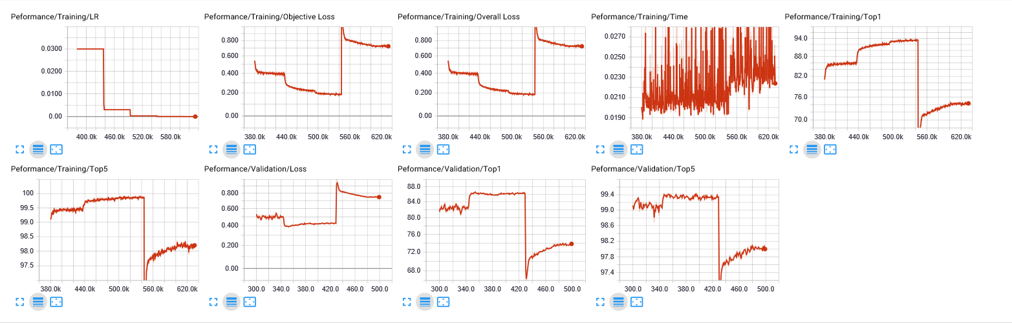
Prunned model
Top1: 73.962 On Epoch: 500
Total MACs : 40,813,184 (same)
Total Weights: 270,896 (same)
Total sparsity: 26.68
USE GPU
CPU times: user 4.87 s, sys: 1.53 s, total: 6.4 s
Wall time: 8.04 s
Not use GPU
CPU times: user 4.9 s, sys: 1.7 s, total: 6.59 s
Wall time: 8.09 s

Slide 13
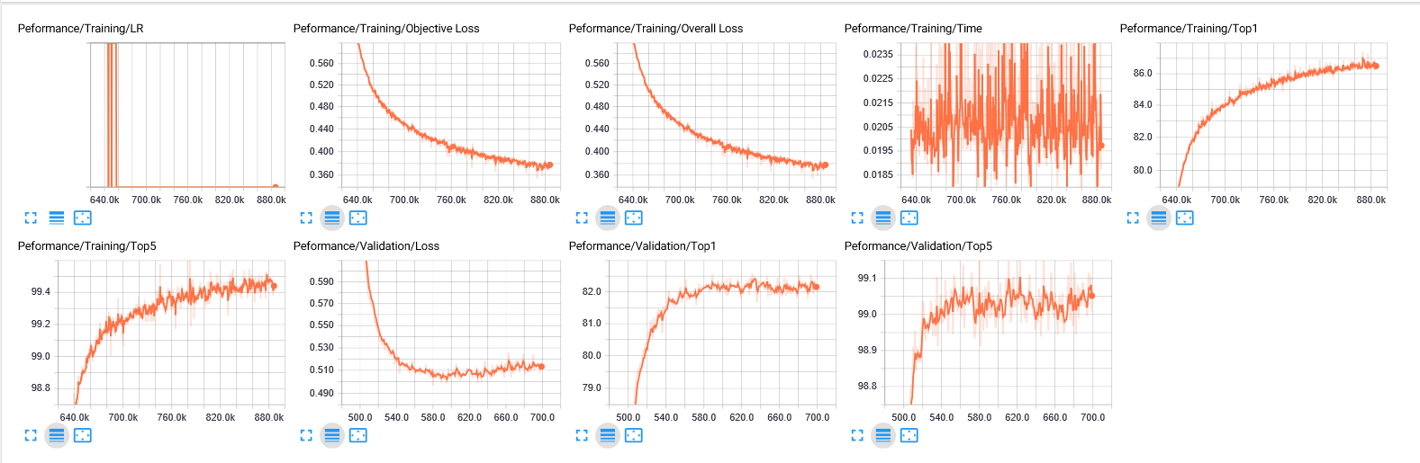
Thinned model
Top1: 82.600 On Epoch: 631
Total MACs : 20,390,528 (less)
Total Weights: 123,296 (less)
Total sparsity: 0.04
USE GPU
CPU times: user 4.81 s, sys: 1.52 s, total: 6.32 s
Wall time: 8.06 s
Not use GPU
CPU times: user 4.82 s, sys: 1.5 s, total: 6.33 s
Wall time: 8.05 s

Slide 14
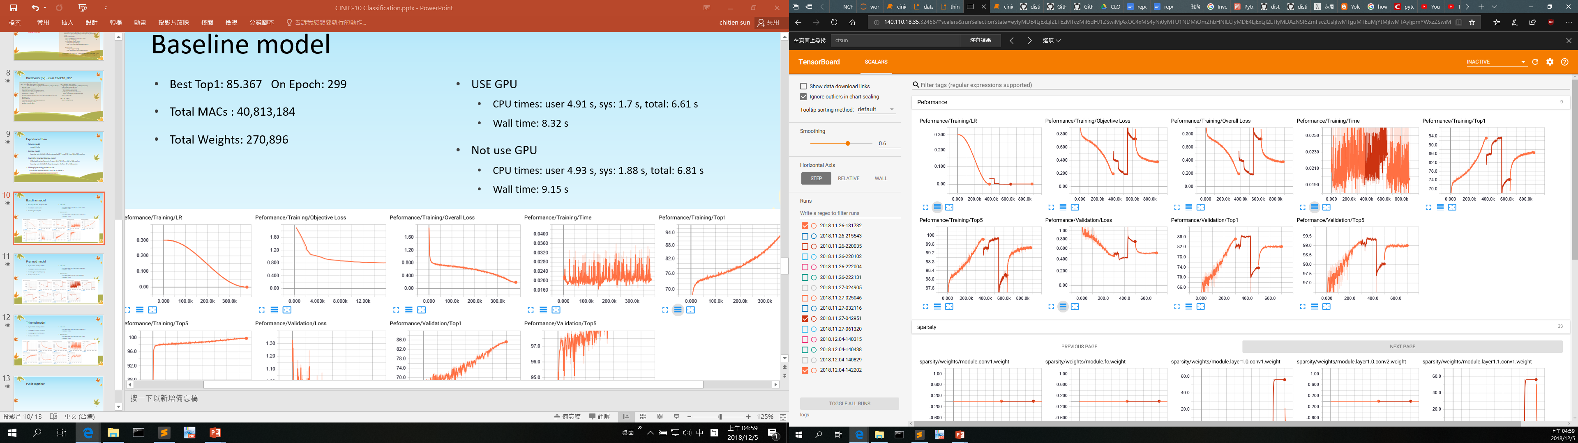
Put it together
 | Accuracy (%) | MACs | Weights | Sparsity (%) | Real time w/ GPU | User time w/ GPU | Sys time w/ GPU | Real time w/o GPU | User time w/o GPU | Sys time w/o GPU
Base | 85.367 | 40,813,184 | 270,896 | 0.00 | 8.32 | 4.91 | 1.7 | 9.15 | 4.93 | 1.88
Pruned | 73.962 | 40,813,184 | 270,896 | 26.68 | 8.04 | 4.87 | 1.53 | 8.09 | 4.9 | 1.7
Thinned | 82.600 | 20,390,528 | 123,296 | 0.04 | 8.06 | 4.81 | 1.52 | 8.05 | 4.82 | 1.5

Slide 15
Final Stage

Slide 16
Observation
Baseline :
150~161 had best accuracy (84%) of validation dataset
162~400 (overfitting)
Challenge
How to avoid overfitting ?
Data augmentation : RandomCrop / RandomHorizontalFlip
Batch Normalization : include in resnet20_cifar
Relu : include in resnet20_cifar
Regularization : Fine-tuning after channel regularization training (SSL) of ResNet20-CIFAR10.
Dropout (~ pruning ?) : Filter Pruning + Thining
Warm-Up (~ pre-train ?) : Failed

Slide 17
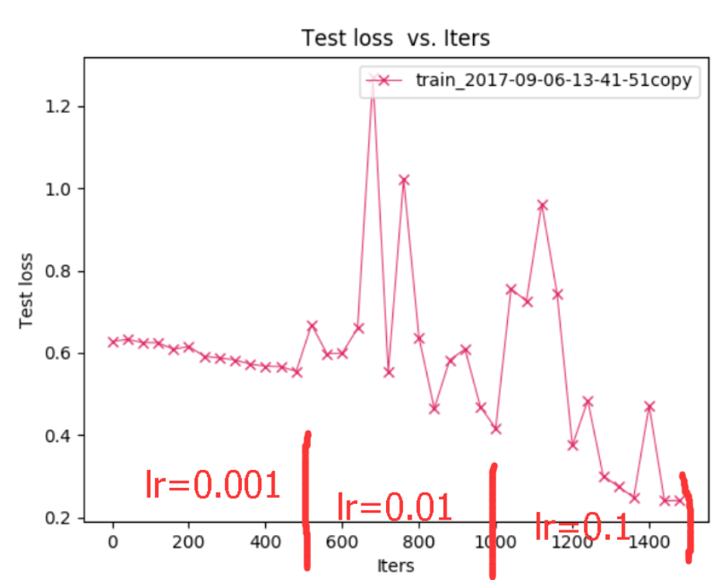
Resnet-18-訓練驗證-warm up操作
一開始分别用了四個初始學習率 lr=0.1; 0.01; 0.001; 0.0001; 然後每1000個iterations就降低一次lr，結果驗證集的accuracy怎麼都上不去，都是0.5~0.6之間，而訓練集的可以到0.99，最後嘗試warm up，網路在驗證集的loss才有所下降
在本專案中，用Resnet20實作1400個epoch，最後失敗
思考是否用pre-train model就可以取代warm up
https://blog.csdn.net/u011995719/article/details/77884728

Slide 18
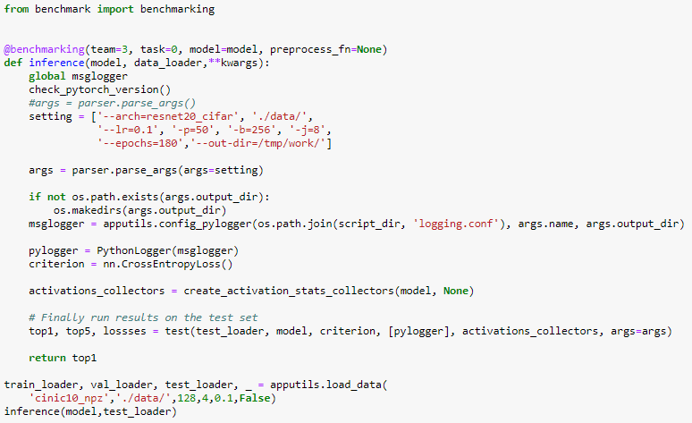
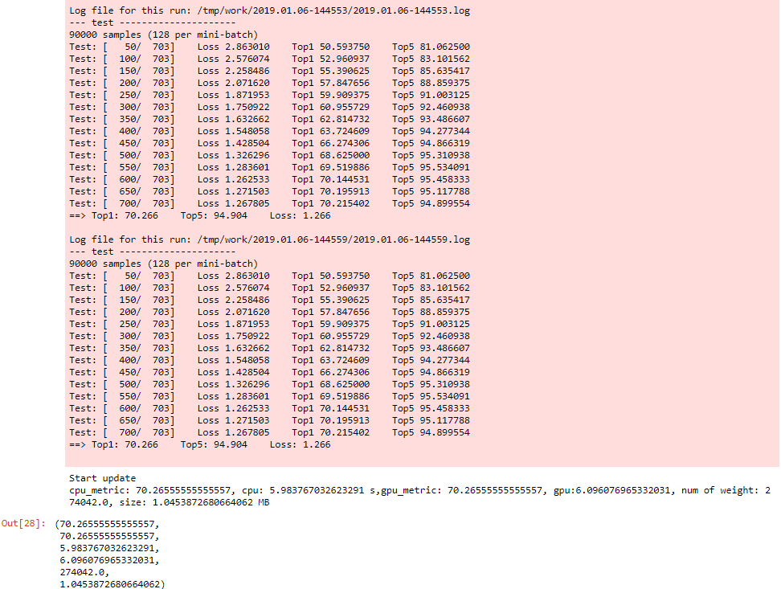
Experimental Results

Slide 19
Super Resolution

Slide 20
Environment preparation
cd /home/dllab/ngraph
source ~/ngraph/onnx/bin/activate
pip install --upgrade pip
pip3 install --force-reinstall torch==0.4.0
cd ~/TensorRT-5.0.2.6/python
pip3 install tensorrt-5.0.2.6-py2.py3-none-any.whl
pip install matplotlib
pip install imageio
pip install tqdm
pip install scikit-image

Slide 21
Usage
Change directory to:
./NCTU_DLSR_final_project/super_resolution/EDSR-PyTorch/src
Command:
$ TESTDATADIR=[PATH to DIV2K VALIDATE DATA] python3 example.py
Make sure your testset are put in directory:
[TESTDATADIR]/DIV2K/DIV2K_valid_HR
and
[TESTDATADIR]/DIV2K/DIV2K_valid_LR_bicubic

Slide 22
Results – In my personal environment
Device | PSNR | Inference Time | num of weight | Model Size (MB)
GPU | 36.132 | 42.77 | 1,369,883 | 5.22
CPU | 36.132 | 710.89 | 1,369,883 | 5.22

Slide 23
Results – In NCHC.ai environment
Device | PSNR | Inference Time | num of weight | Model Size (MB)
GPU | 36.132 | 32.263 | 1,369,883 | 5.22
CPU | 36.132 | OOM | 1,369,883 | 5.22

Slide 24
Method
Stick in original EDSR model and to see what we can do.
nGraph CPU inference enhancement
TensorRT GPU inference enhancement, not mush extra we can gain by comparison with normal Pytorch GPU inference.
Distillation to compress model size. Complex work, but can do for the future work.
Conclusion:
Focus on nGraph CPU inference enhancement

Slide 25
Step 1 – Get full model
Command
python edsr_main.py --dir_data './' --data_test valid --scale 2 --pre_train './edsr_baseline_download.pt' --test_only --resave_full_model 'edsr.model‘
In option.py, add code:
parser.add_argument('--resave_full_model', type=str, default='',
help='resave a full model')
In model/__init__.py, add code:
class Model(nn.Module):
def __init__(self, args, ckp):
...
self.resave_full_model = args.resave_full_model
def load(self, apath, pre_train='', resume=-1, cpu=False):
…
if self.resave_full_model: torch.save(self.get_model(), self.resave_full_model)

Slide 26
Step 2 - Dynamically Convert to nGraph model according to input image size
def test(self):
...
if self.args.ngraph:
pytorch_model_name = self.args.ngraph
pytorch_edsr_model = torch.load(pytorch_model_name)
dummy_input = torch.randn_like(lr, device='cuda')
edsr_onnx_filename = '{}.onnx'.format(pytorch_model_name)
torch.onnx.export(pytorch_edsr_model, dummy_input, edsr_onnx_filename, export_params=True, verbose=False, training=False)
import os
import onnx
edsr_onnx_model = onnx.load(edsr_onnx_filename)
from ngraph_onnx.onnx_importer.importer import import_onnx_model
ng_models = import_onnx_model(edsr_onnx_model)
import ngraph as ng
ng_model = ng_models[0]
runtime = ng.runtime(backend_name='CPU')
edsr_ng_model = runtime.computation(ng_model['output'], *ng_model['inputs'])
sr = edsr_ng_model(lr, idx_scale)
sr = torch.from_numpy(sr)

Slide 27
Crash again and again for CPU inference on NCHC.ai environment
How about Original EDSR
CASE a:
pip3 install --force-reinstall torch==0.4.0
cd /tmp/work/chilung/org_edsr/EDSR-PyTorch/src
python main.py --dir_data './' --data_test Set5 --scale 2 --pre_train './edsr_baseline_download.pt' --test_only --cpu
RESULT:
Crash after inference just 2 images & 9 images
CASE b:
pip3 install --force-reinstall torch==0.4.1
cd /tmp/work/chilung/org_edsr/EDSR-PyTorch/src
python main.py --dir_data './' --data_test Set5 --scale 2 --pre_train './edsr_baseline_download.pt' --test_only --cpu
RESULT:
hang up after inference just 9 images
How about stand alone ngraph
CASE c:
As prepare environment 0.4.1 fail for onnx not support dynamic reshape.
CASE d:
As prepare environment 0.4.0
RESULT:
pass for inferencing 10 images (224x224)
pass for inferencing 100 images (224x224)
lr.to.cuda: pass for inferencing 100 images (224x224)
lr.to.cuda: fail for just inferencing 1 images (1024x1024)
EDSR ngraph (As prepare environment 0.4.0)
CASE e:
RESULT:
fail for just inferencing 2 valid dataset images, twice
Original EDSR 1.0.0 with Pytorch 1.0.0
CASE f:
git clone https://github.com/thstkdgus35/EDSR-PyTorch.git
pip install torch==1.0.0
cd /tmp/work/chilung/edsr100/EDSR-PyTorch/src
RESULT:
fail for just inferencing 2 valid dataset images
CASE g:
EDSR sr/, torch==0.4.1
Test dataset Urban100
RESULT:
pass for inferencing 100 Urban100 dataset images
pin_memory = False, move import out of loop
CASE g:
RESULT:
fail for just inferencing 1 valid dataset images
stand alone ngraph with inference only w/ dynamic convert pytorch to ngraph
CASE h:
Tt.py
1024x1024
RESULT:
fail for just inferencing 1 valid dataset images
Try to rebuild onnx/ngraph environment
CASE i:
RESULT:
crash while $ python3 setup.py bdist_wheel

Slide 28
Check Memory Limit and Usage in a container
Check memory limit:
$ cat /sys/fs/cgroup/memory/memory.limit_in_bytes 10,737,418,240
Check memory Usage:
$ cat /sys/fs/cgroup/memory/memory.usage_in_bytes

Slide 29
More testing result EDSR_baseline_x2 (resblocks=16/feats=64)
GPU | CPU | GPU Ensemble
[Set5 x2] PSNR: 37.802 [Set14 x2] PSNR: 33.360 [B100 x2] PSNR: 32.040 [Urban100 x2] PSNR: 31.463 [DIV2K x2] PSNR: 34.410 | [Set5 x2] PSNR: 37.802 [Set14 x2] PSNR: 33.360 [B100 x2] PSNR: 32.040 [Urban100 x2] PSNR: 31.463 [DIV2K x2] PSNR: 34.410 | [Set5 x2] PSNR: 37.928 [Set14 x2] PSNR: 33.473 [B100 x2] PSNR: 32.105 [Urban100 x2] PSNR: 31.664 [DIV2K x2] PSNR: 34.513
Forward: 62.03s (GPU) | Forward: 6486.61s (CPU) | Forward: 491.67s (GPU)

Slide 30
More testing result EDSR_baseline_x3 (resblocks=16/feats=64)
GPU | CPU | GPU Ensemble
[Set5 x3] PSNR: 34.263 [Set14 x3] PSNR: 30.232 [B100 x3] PSNR: 29.035 [Urban100 x3] PSNR: 27.917 [DIV2K x3] PSNR: 30.922 | [Set5 x3] PSNR: 34.263 [Set14 x3] PSNR: 30.232 [B100 x3] PSNR: 29.035 [Urban100 x3] PSNR: 27.917 [DIV2K x3] PSNR: 30.922 | [Set5 x3] PSNR: 34.393 [Set14 x3] PSNR: 30.326 [B100 x3] PSNR: 29.090 [Urban100 x3] PSNR: 28.038 [DIV2K x3] PSNR: 31.001
Forward: 36.68s (GPU) | Forward: 3245.74s (CPU) | Forward: 289.41s (GPU)

Slide 31
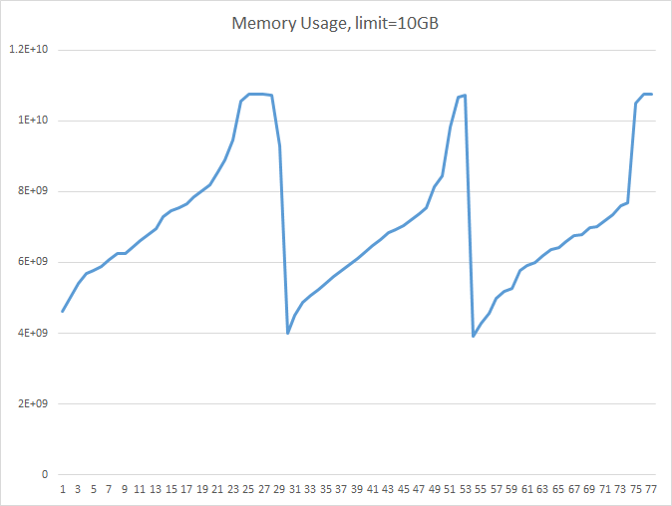
Memory Usage Fail situation: perform CPU inference after 5 valid dataset

Slide 32
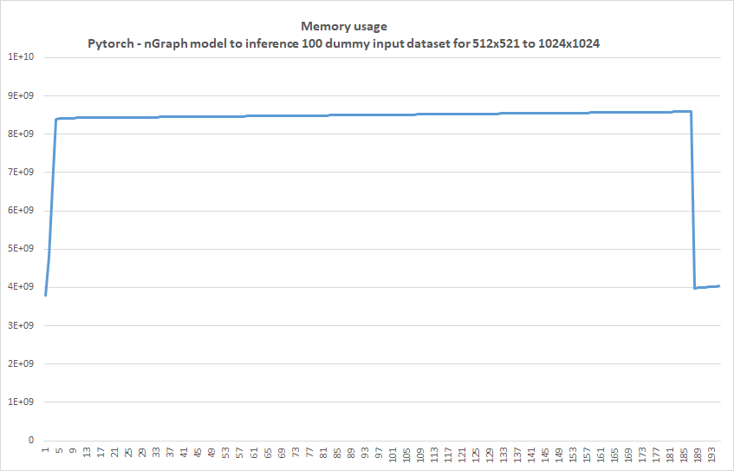
Memory Usage: Pass: perform CPU inference after 5 valid dataseton 100 dummy input dataset for SR from 512x521 to 1024x1024

Slide 33
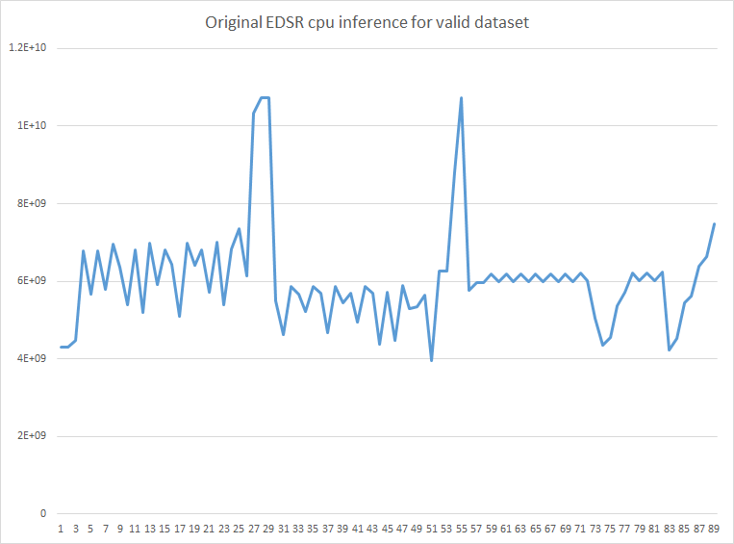
Memory Usage: Fail: Perform original EDSR CPU inference after 2 valid dataset

Slide 34


Super Resolution Result – scale x2
Original Low Resolution Image
Super Resolution Result

Slide 35


Super Resolution Result – scale x3
Original Low Resolution Image
Super Resolution Result

Slide 36


Super Resolution Result – scale x4
Original Low Resolution Image
Super Resolution Result

Slide 37
Clothes Detection on CLOTHES

Slide 38
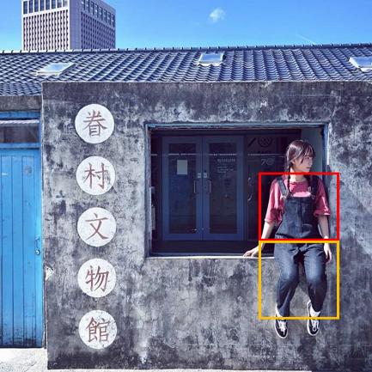
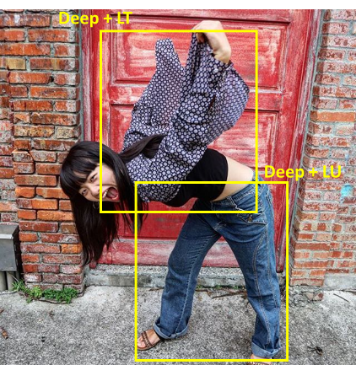
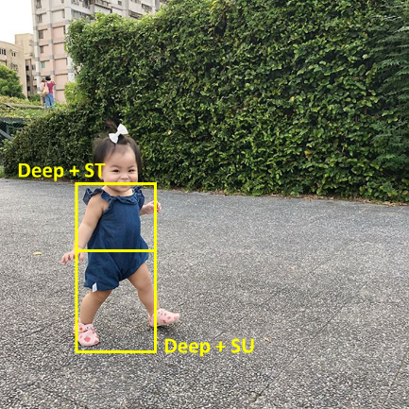
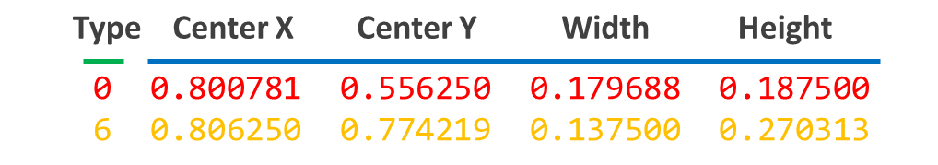
What is CLOTHES
Dataset for where the clothes are (bounding box) and what kind of clothes:
Short Top with Deep / Light color: 1 Light + ST / 0 Deep + ST
Long Top with Deep / Light color: 3 Light + LT / 2 Deep + LT
Short under with Deep / Light color: 5 Light + SU / 4 Deep + SU
Long under with Deep / Light color: 7 Light + LU / 6 Deep + LU
Label

Slide 39
Model Configurations
Full YOLOV3
NMS Threshold = 0.4
IOU Threshold = 0.5
Confidence Threshold = 0.25
Initial Learning Rate = 0.001
max_batches = 50,000
How to train
Data augmentation: Flip, Shift, Scale
K-fold Cross Validation
Weight initial value: yolov3.weights
For the private test procedure, additional use the public test dataset as the training set

Slide 40
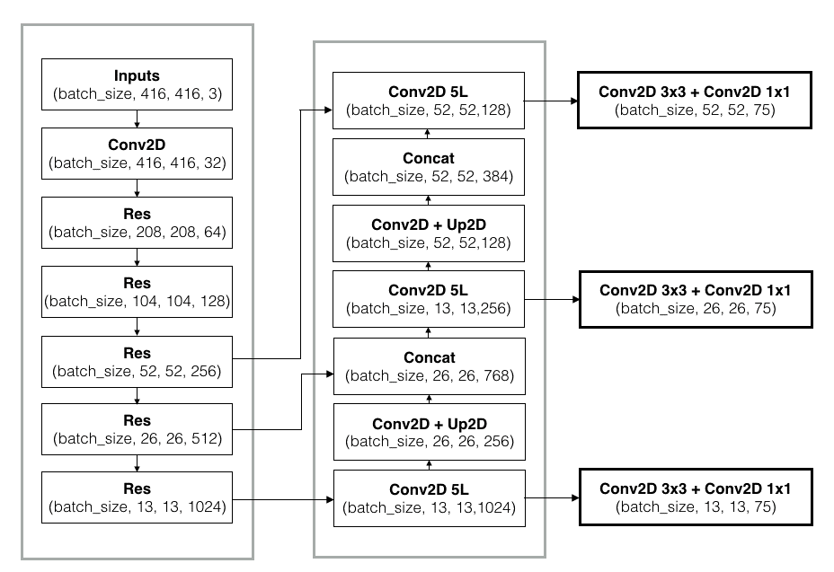
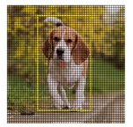
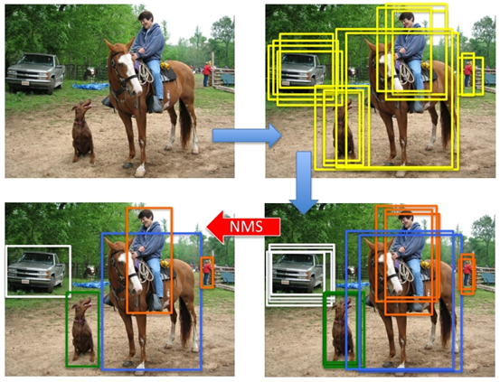
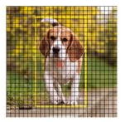
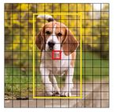
Inference
Working flow:
Darknet-53 ➔ FPN ➔ Get all boxes ➔ NMS ➔ Scoring
TensorRT
Generate ONNX ➔ Build TensorRT Engine ➔ Inference
Prediction (Pred)
Ground Truth (GT)
Darknet-53
FPN
Get all boxes
NMS
Scoring

Slide 41

Score Definition and Results
Prediction (Pred)
Definition:
$IOU=\frac{GT ∩ Pred}{GT ∪ Pred}$
$Recall=\frac{GT ∩ Pred}{GT}$
$Precision=\frac{GT ∩ Pred}{Pred}$
$\text{F}\text{−}\text{Score}=\left(1+β^{2}\right)∙\frac{Precision ∙ Recall}{β^{2 }∙ Precision + Recall}$
Importance:
$Precision> Recall$, then $β<1$
Equally, then $β=1$
Timing Budget:
Import packages: 0.859 s
Build model and Load weights: 4.152 s
YOLO3 inference: 1.026 s
Get all boxes: 8.548 s
Calculate scores: 1.71 s
Ground Truth (GT)
Items | Results
F-Score | 0.76
CPU time (s) | 207 @ batch size = 5
 | 227 @ batch size =4
GPU times (s) | 18 @batch size =13
 | 20 @batch size =10
Weight Num. | 62,001,829
Weight Size | 236.5 MB

Slide 42
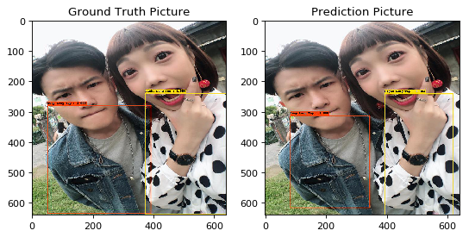
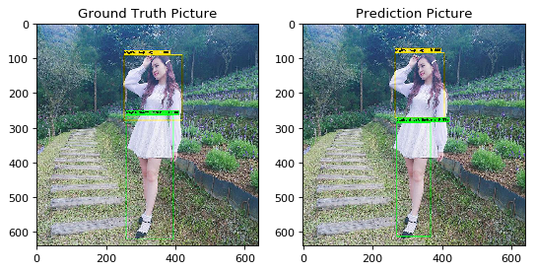
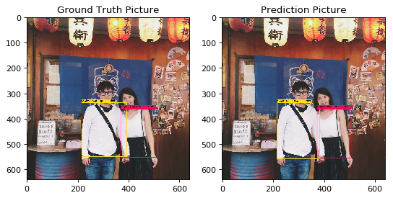
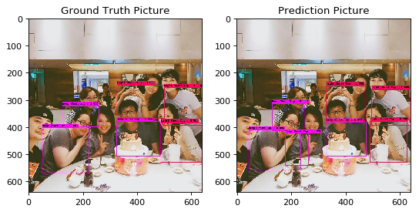
Experiment Results

Slide 43
Discussion
F-Score = 0.76 @ training dataset = train
F-Score = 0.98 @ training dataset = train + test
Different setting between CPU and GPU case
Best batch size → CPU: 5, GPU: 13 (memory limit)
Model architecture → GPU: torch.nn.DataParallel(model)
TensorRT computation time is not good
42s (tensorRT) v.s. 20s (pytorch)

